Slide 1
Ch3 Understanding Software Architecture
Software System Design and Architecture
Ding Er-Yu
Software Institute, Nanjing University

Slide 2
阅读资料
《理解软件体系结构》

Slide 3
Main Contents
Motivation of Software Architecture
Understanding Software architecture: High-Level Structures
Understanding Software architecture: Communication (Concerns)
Understanding Software Architecture: Design Decisions
Architect

Slide 4
Motivation of Software Architecture
Analogy: Architecture of Buildings
  Dewayne E. Perry, Alexander L. Wolf, 1992
  《Foundations for the study of software architecture》
Programming-in-the-Small VS Programming-in-the-Large
  Mar Shaw, 1993
  《Procedure Calls are the Assembly Language of Software Interconnections: Connectors Deserve First-Class Status》

Slide 5
Analogy: Architecture of Buildings
Architecture is different from, but linked with the product/structure
From detail-design to program are all implementation(product structure), not architecture
  Allocation of software entities, not plan of responsibilities assignment
Properties of structures are induced by the design of the architecture
The architect has a distinctive role and character

Slide 6
Building Architecture
multiple views;
architectural styles;
style and engineering;
style and materials.

Slide 7
Programming-in-the-Small VS
Programming-in-the-Large
详细设计的局限性：使用Module和（单词匹配的）导入/导出关系
  关注点偏差（载体失配）
  无法实现交互信息本地化（信息隐藏局限性）
  无法有效抽象部件的整体特性（无法描述Module Itself）
  接口的定义缺乏结构性
  不能有效适应大型软件的特殊开发方法

Slide 8
What is a software architecture?
  Perry and Wolf：《Foundations for the study of software architecture》
  Software Architecture = { Elements, Form, Rationale }
  what how why
    Elements= Process + Data + Connection (glue)
    Form= Property + Relationship
    Property: Constraints on an element
    Relationship: Constraints on an interaction of elements
    Rational: captures the motivation for the choice of architectural style, the choice of elements, and the form.

Slide 9
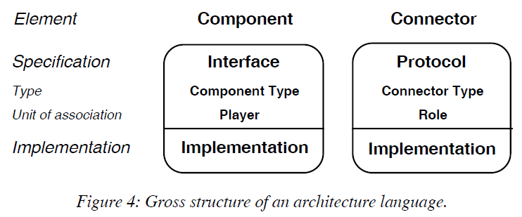
What is a software architecture?
M. Shaw, etc. 1995,《Abstractions for Software Architecture and Tools to Support Them》. IEEE Transactions on Software Engineering,.
  Software Architecture =
  { Component + connector+ configuration }

Slide 10
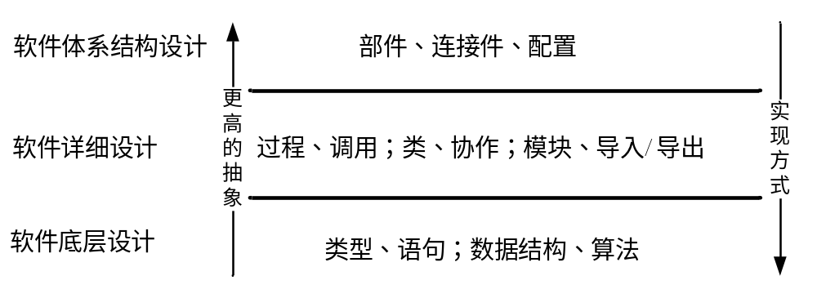
Programming-in-the-Large
High-Level Structures
Hiding Programming Mechanisms (Import/Export, and words matching)
Module Itself with Quality Property→ Component
Interactions of Component → Connector
  Structural
  None (Programming Mechanisms) implementation Considerations
  Independent to component

Slide 11
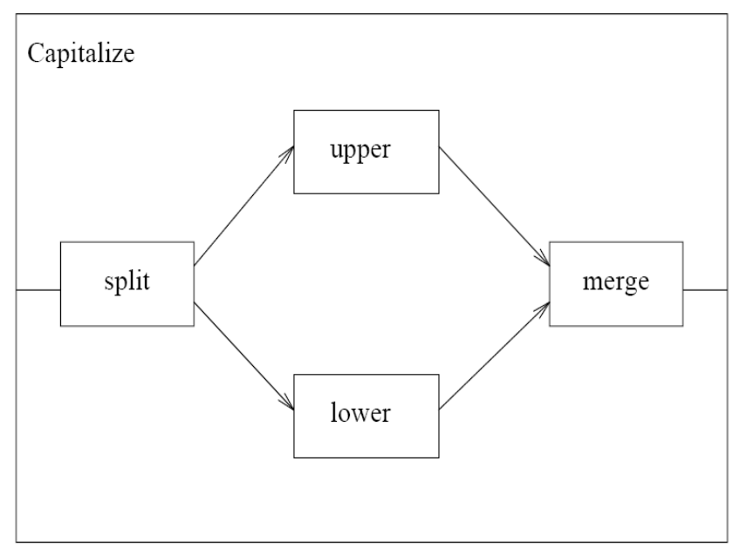
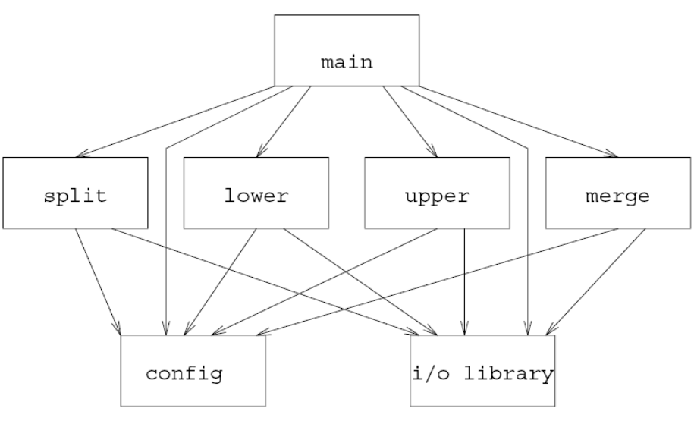
High-Level Structures
Abstract specification VS Implementation
  Functional organizations VS implemented mechanisms to software

Slide 12
Main Contents
An Introduction to Software Architecture
Understanding Software architecture: High-Level Structures
Understanding Software architecture: Communication (Concerns)
Understanding Software Architecture: Design Decision
Architect

Slide 13
High-Level Structures
Components are the locus of computation and state
Connectors are the locus of relations among components
  Connector deserve first-class

Slide 14
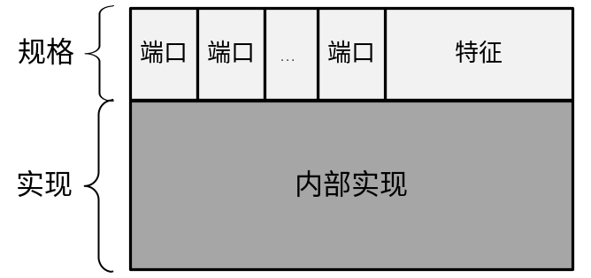
Components
Elements that encapsulate processing and data in a system’s architecture are referred to as software components
Definition
  A software component is an architectural entity that
    encapsulates a subset of the system’s functionality and/or data
    restricts access to that subset via an explicitly defined interface
    has explicitly defined dependencies on its required execution context
Components typically provide application-specific services

Slide 15
Components
The interface defines
Name: the component type
Property: assertions and constraints that apply to the entire component
Port: the players which form the bulk of the interface, are the visible semantic units through which the component can interact, request and provide services, or be influenced by external state or events.

Slide 16
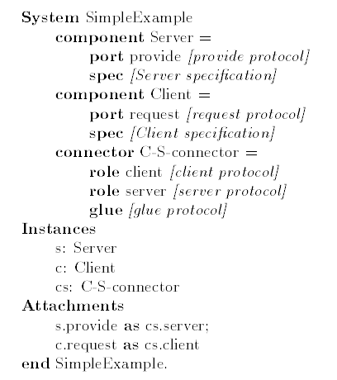


Slide 17
Components Implementation
Primitive Components
Composite components
  Configuration of smaller components and connectors
软件实现机制 | 示例
模块(Module) | Routine, SubRoutine
层(Layer) | View, Logical, Model
文件(File) | DLL, EXE, DAT
数据库(Database) | Repository, Center Data
进程(Process) | Sender, Receiver
网络节点(Physical Unit) | Client, Server

Slide 18
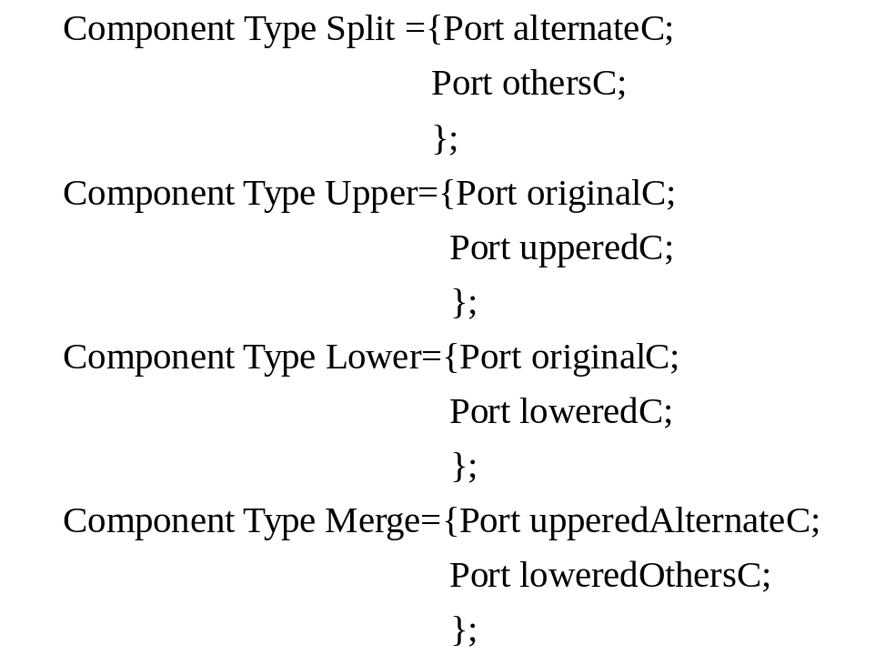
Components
列举 Components
ACME

Slide 19
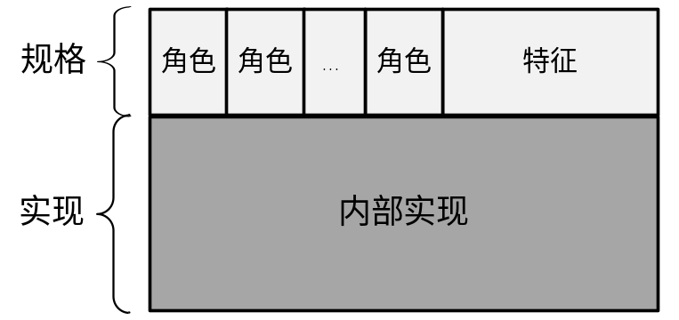
Connectors
In complex systems interaction may become more important and challenging than the functionality of the individual components
Definition
  A software connector is an architectural building block tasked with effecting and regulating interactions among components
  They mediate interactions but are not “things” to be “hooked up;” rather, they provide the rules for hooking-up.
Connectors typically provide application-independent interaction facilities

Slide 20
High-Level Structures
Connectors are properly treated separately from components
  The definition of a connector should be localized
  Connectors may be quite sophisticated.
  Some information about the system does not have a proper home in any component
  All elements of a structure are “independent”
    Components should be independent
    Connectors should be independent
    Relations among components are not fixed.

Slide 21
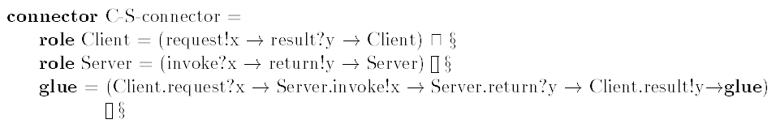
CSP
!:Input, ?:output
: P or Q, Internal choice
: P or Q, External choice

Slide 22
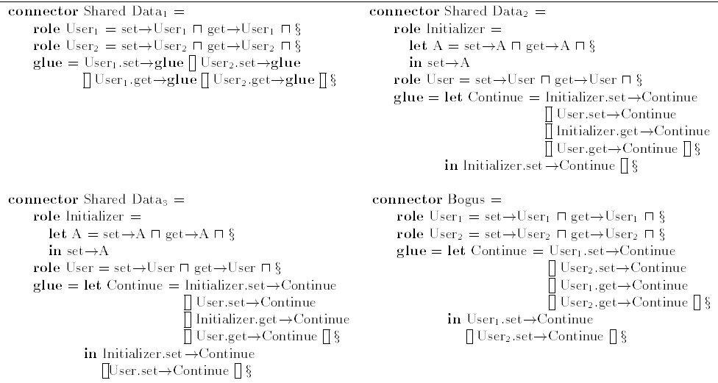

Slide 23
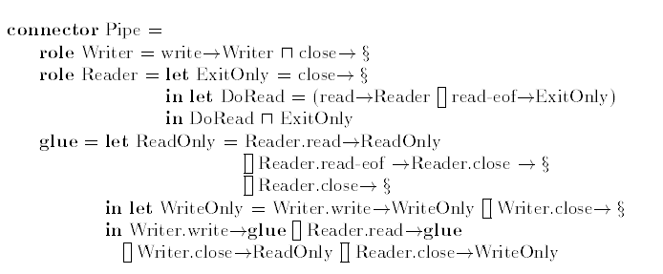

Slide 24
Connector implementation
Primitive connectors
Composite connectors
    Configuration of smaller components and connectors
实现类型 | 软件实现机制 | 提供方
隐式（Implicit） | 程序调用（Procedure Call） | 编程语言机制
 | 共享变量（Shared variable）
 | 消息（Message） | 平台、框架或高级语言机制
 | 管道（Pipe）
 | 事件（Event）
 | 远程过程调用（RPC）
 | 网络协议（Network Protocol）
 | 数据库访问协议（Database Access Protocol）
显式（Explicit） | 适配器（Adaptor） | 复杂逻辑实现
 | 委托（Delegator）
 | 中介（Intermediate）
Notes:
实现类型
软件实现机制
提供方
隐式（Implicit）
程序调用（Procedure Call）
编程语言机制
共享变量（Shared variable）
消息（Message）
平台、框架或高级语言机制
管道（Pipe）
事件（Event）
远程过程调用（RPC）
网络协议（Network Protocol）
数据库访问协议（Database Access Protocol）
显式（Explicit）
适配器（Adaptor）
复杂逻辑实现
委托（Delegator）
中介（Intermediate）

Slide 25

Connector
ACME

Slide 26
Configurations
Components and connectors are composed in a specific way in a given system’s architecture to accomplish that system’s objective
Definition
  An architectural configuration, or topology, is a set of specific associations between the components and connectors of a software system’s architecture

Slide 27
Architectural Structure
configuration
connector
component
port
role
Port, role与详细设计的Interface有什么区别？

Slide 28
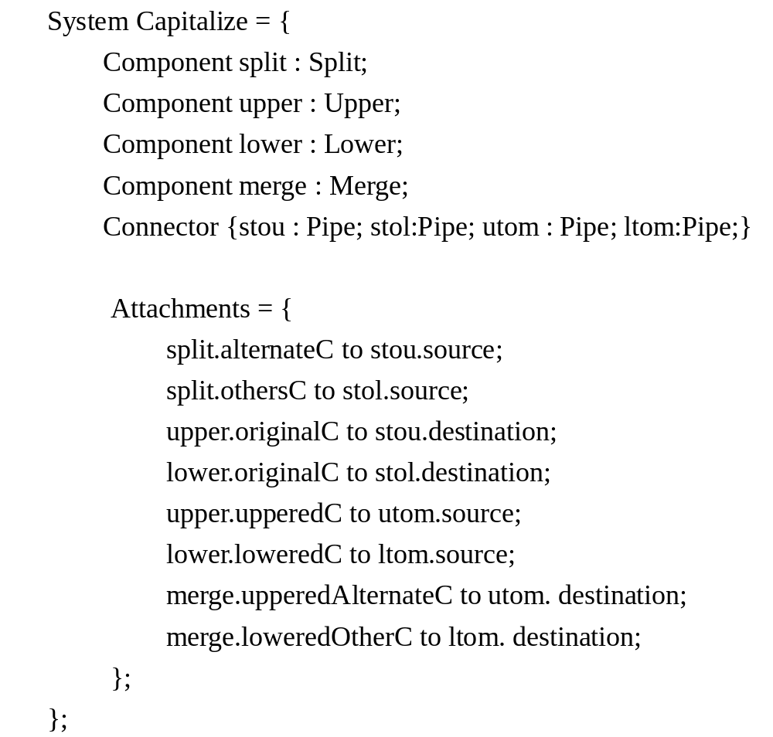
Configurations
ACME

Slide 29
Main Contents
An Introduction to Software Architecture
Understanding Software architecture: High-Level Structures
Understanding Software architecture: Communication (Concerns)
Understanding Software Architecture: Design Decision
Architect

Slide 30
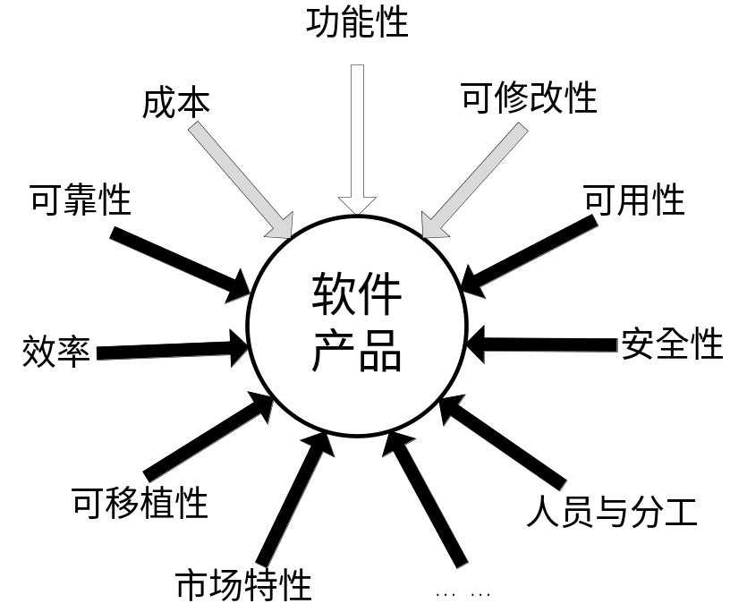
How to get a software architecture…
  在大型软件系统的开发中，质量属性是影响软件系统复杂度的关键因素，软件体系结构是处理质量属性和控制复杂性的主要手段，质量属性是软件体系结构最为重要的关注点。
  为什么？

Slide 31
Concernses of Software Architecture
<Software Architecture in Practice>
Qualities of the system
  availability, modifiability, performance, security, testability, and usability.
Project Environments
  Development Environments
  Business Environments
  Technology Environments
Business Goals

Slide 32
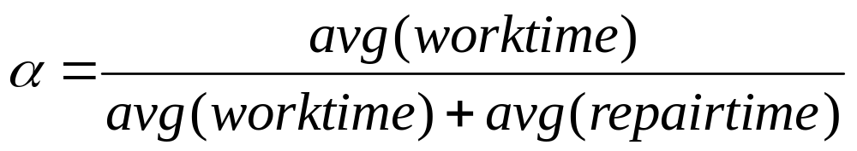
Qualities of the system
—Availability
Mostly depend on architectural aspects:
  Design fault tolerance to extend work-time
    Replication of key components or channels
  Design a less fault system to extend work-time
    Separation relation concerns
  Design a component apt to be modified to shorten repair-time
  Design a component interaction apt to find errors to shorten repair-time

Slide 33
Qualities of the system
— Modifiability
The quality attribute most close to architecture
  Localize Modifications
    Anticipate expected changes
  Prevent Ripple Effects
    Hide information
    Restrict communication paths
    Use an intermediary
  Defer Binding Time
    Configuration files
    Polymorphism
    Component replacement

Slide 34
Qualities of the system
— Performance
The performance of a systems depends on both architectural and non-architecture aspects.
Architectural aspects of Performance:
  Communication between components
  Partially on partitioning of functionality
  Allocation of resources
Non-architectural aspects of Performance:
  Choice of algorithms
  How these algorithms are coded

Slide 35
Qualities of the system
— Security
Security aspects:
  Resisting attacks
  Detecting attacks
  Recovering from attacks
Mostly depend on architectural aspects
  Set authentication server
  Monitor and log network event
  Building system based on services provided by a authentic kernel

Slide 36
Qualities of the system
— Testability
Testability aspects:
  Input/Output
  Internal monitoring
Mostly depend on architectural aspects
  Modularize and encapsulate problems

Slide 37
Qualities of the system
— Usability
Examples of architectural aspects of usability
  “Undo” pattern
  Feedback Pattern
  …
Non-architectural aspects of usability :
  Should we use radio button or check box?
  What font?

Slide 38
Environments— Development
Staff skills
  Buildability with fixed staff
Cost
    Using familiar technique to keep low cost
    Outsourcing
Time to market
  Using COTS if urgent
Resources
  Buildability with fixed resources
  Integration with legacy systems
    Analyze the integrating requirements with the legacy systems

Slide 39
Environments— Business
Benefit
  Creativity with high risk and high benefit
Projected lifetime of system
  Modifiability and portability preferred for long lifetime
Targeted market
  Making PL for large market
Rollout schedule
  If a product is to be introduced as base functionality with many features released later, the flexibility and customizability of the architecture are important

Slide 40
Environments—Technology
Platforms
Hardware Devices
Developments Tools
Technology models and standards

Slide 41
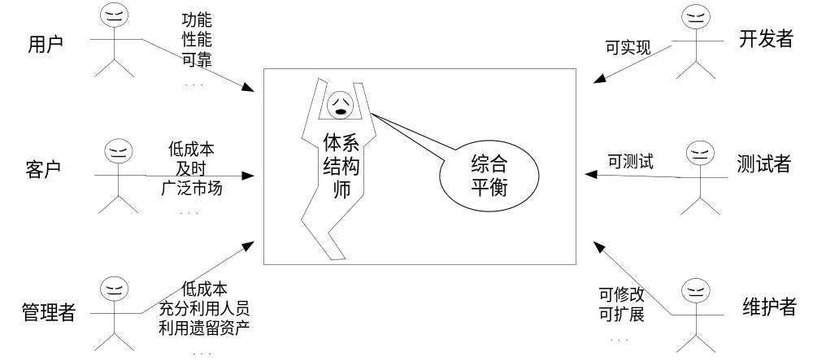

Slide 42
An Example
Software architecture of a web-based system?
Client 1
Client 2
Web-server
Application Server
DB
Client n

Slide 43
An Example
A simple architecture
学生
教师
查询、借书、还书等操作界面
查询、借书、还书等
图书及借阅信息
图书管理员

Slide 44
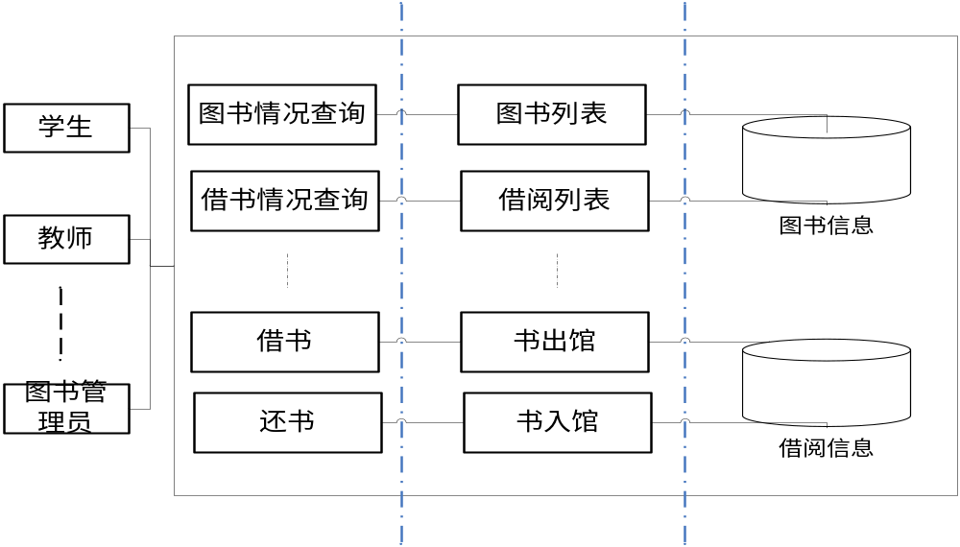
An Example
Better?
A better architecture

Slide 45
Main Contents
An Introduction to Software Architecture
Understanding Software architecture: High-Level Structures
Understanding Software architecture: Communication (Concerns)
Understanding Software Architecture: Design Decision
Architect

Slide 46
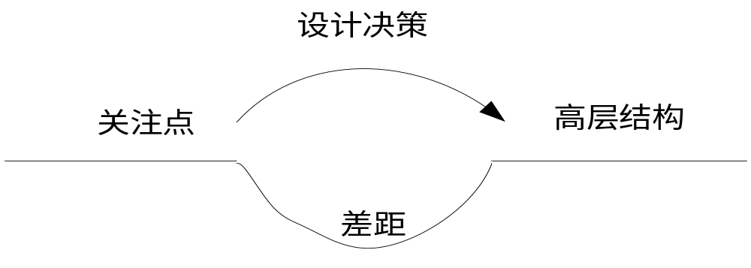
What is Software Architecture?
Another Definition recently
  A software system’s architecture is the set of principal design decisions about the system
“Principal” implies a degree of importance that grants a design decision “architectural status”
  It implies that not all design decisions are architectural
  That is, they do not necessarily impact a system’s architecture

Slide 47
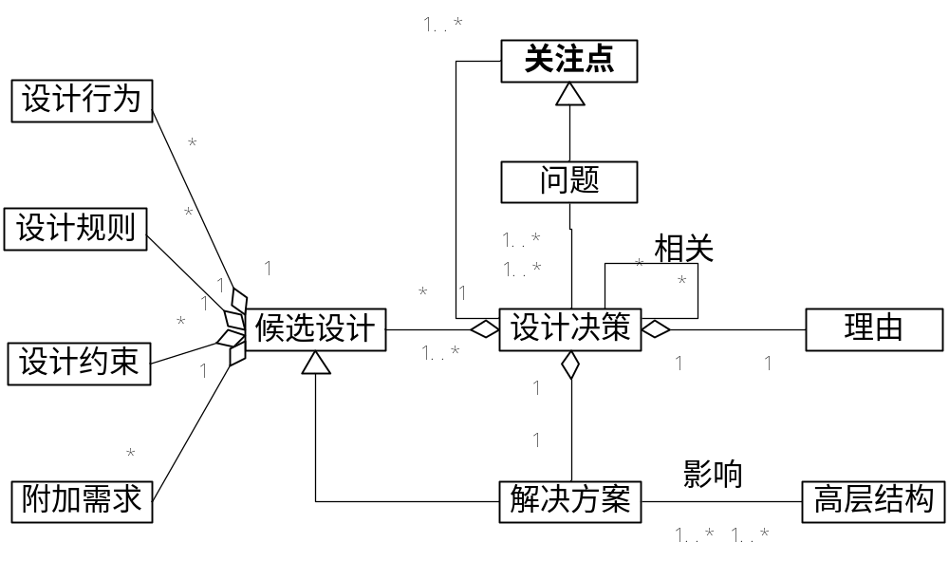
design decision

Slide 48
Why architectural design decisions are important and difficult?
Design decisions are cross cutting and intertwined:
  the design decision information is fragmented across various parts of the design, making it hard to find and change the decisions.
Design rules and constraints are violated:
  designers can easily violate design rules and constraints arising from previously taken design decisions
  lead to architectural drift and its associated problems
Obsolete design decisions are not removed
  In the current design practice removing design decisions is avoided, because of the effort needed, and the unexpected effects this removing can have on the system.

Slide 49
The design decisions been lost…
Solutions survive
But the design decisions have been lost
  When do additions, subtractions and modifications to the software architecture happen, where is the rational?
  How to do?

Slide 50
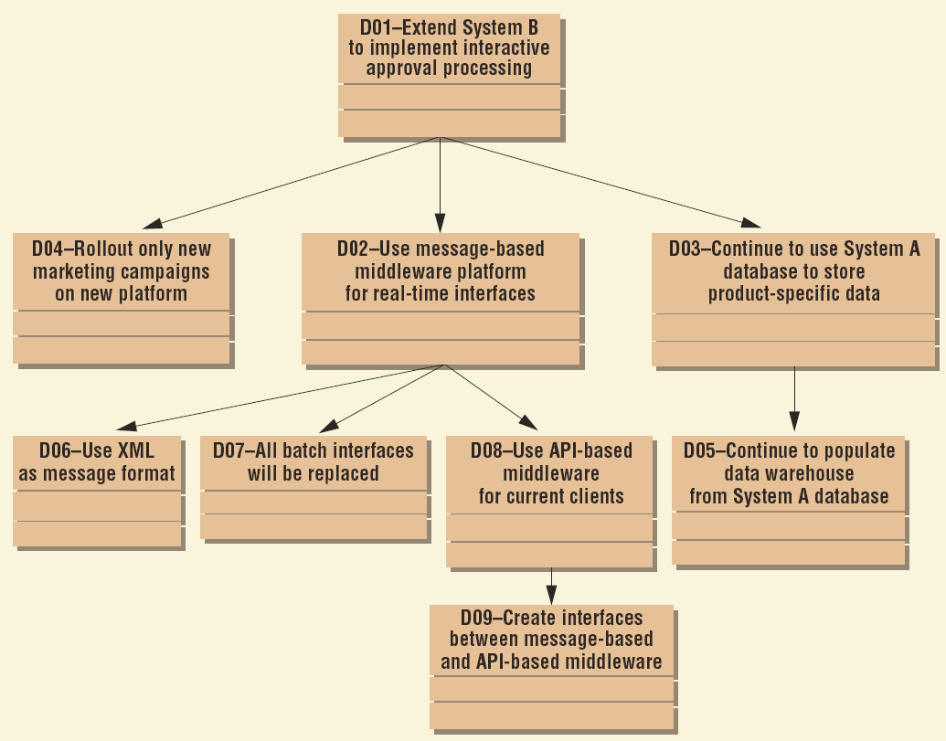
An example

Slide 51
Main Contents
An Introduction to Software Architecture
Understanding Software architecture: High-Level Structures
Understanding Software architecture: Communication (Concerns)
Understanding Software Architecture: Design Decision
Architect

Slide 52
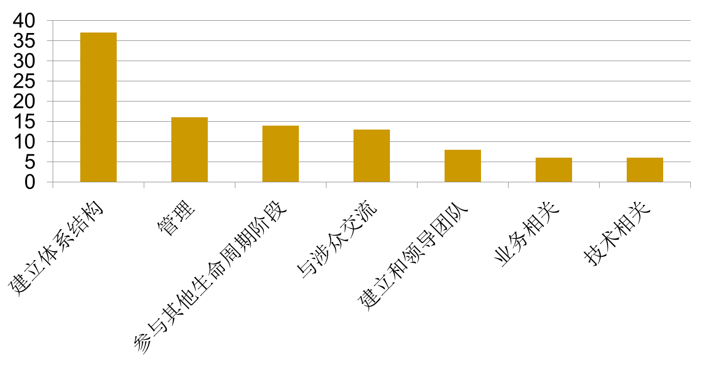
Who are the Architects?
Architecture team
  balance

Slide 53
Architect Role
Not a designer
  Need to ensure feasibility
Not a project manager
  But “joined at the hip”
Not a scientist
  Needs to find solutions
Not a user
  Needs to understand the problems

Slide 54
Misconceptions about architecture
Architecture is the whole design
Architecture is just paper
Architecture and design are the same things
Architecture and infrastructure are the same things
<my favorite technology> is the architecture

Slide 55
Some concepts be apt to be confused
Enterprise architecture
  Business architecture
    strategies, organizations, objectives, processes
  Application architecture
    Principles applied to unify different software, sometimes the same as software architecture
  Technology/base architecture
    Environments software depends on (hardware ,network, os, mw, etc)
  Data (Information) architecture
    Data structures, data storages, data processes
Product line architecture
  Defines the software architecture of a product family
Reference architecture
  Defines the software architecture of an application domain

Slide 56
？

